Slide 1
Adaptive Linear Neuron
Adaline

Slide 2
Characteristics of the Perceptron
A binary classifier
Limited to linearly separable classes
Finds a linear separation if one exists, not an “optimal” separation

Slide 3
Adaptive Linear Neuron
Adaptive Linear Element (later)
Adaline (ADAptive LInear NEuron)
Developed by Widrow and Hoff (1960)
A single-layer Neural Network
Utilizes a cost function
Replaces the step activation function of the Perceptron with a linear activation function and a quantizer.

Slide 4










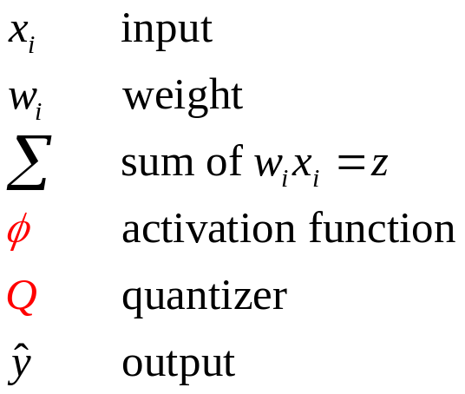


An Adaline model
Δw
Inputs
…
Δw
= adjustments to w

Slide 5
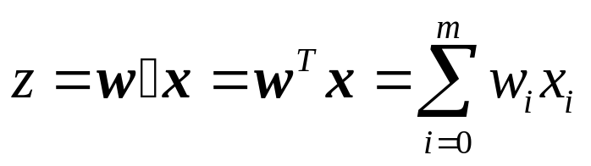





Adaline activation function,

Slide 6
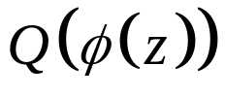
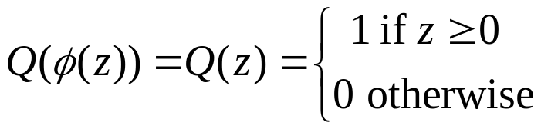
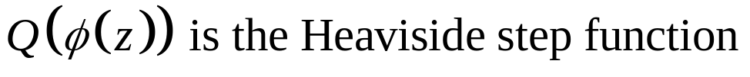
Adaline quantizer

Slide 7
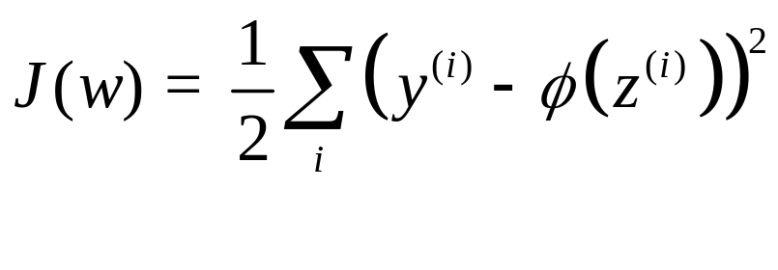
Cost function
J(w) is a convex function and, therefore, we can use the technique of gradient descent to find a minimum and a local minimum is the global minimum.

Slide 8
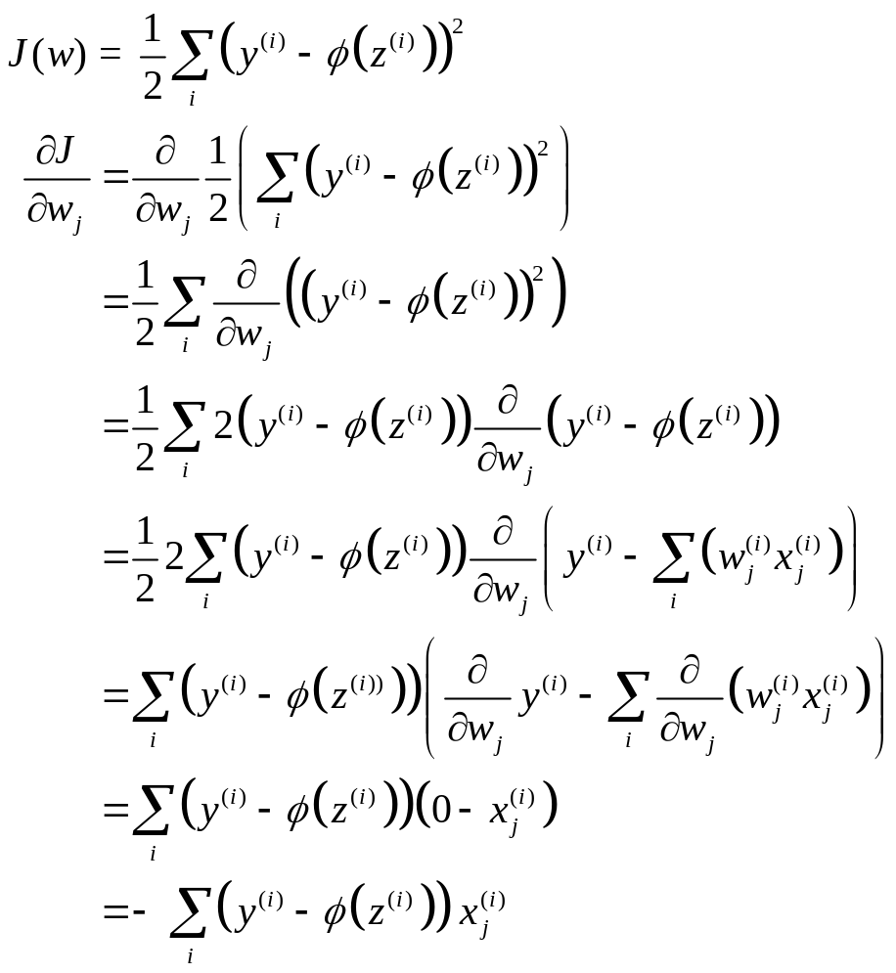
First derivative of the cost function (1)

Slide 9
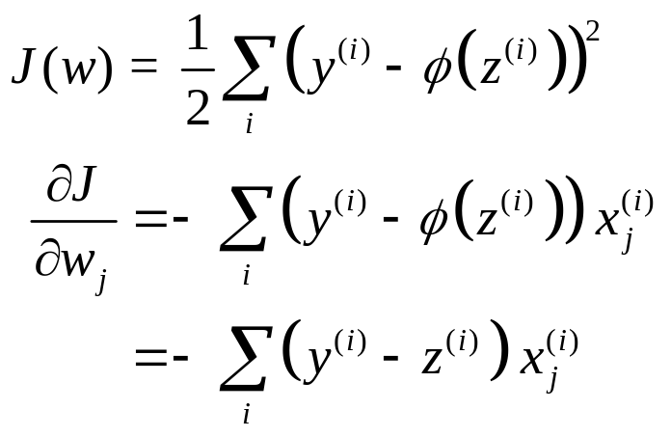
First derivative of the cost function (2)

Slide 10
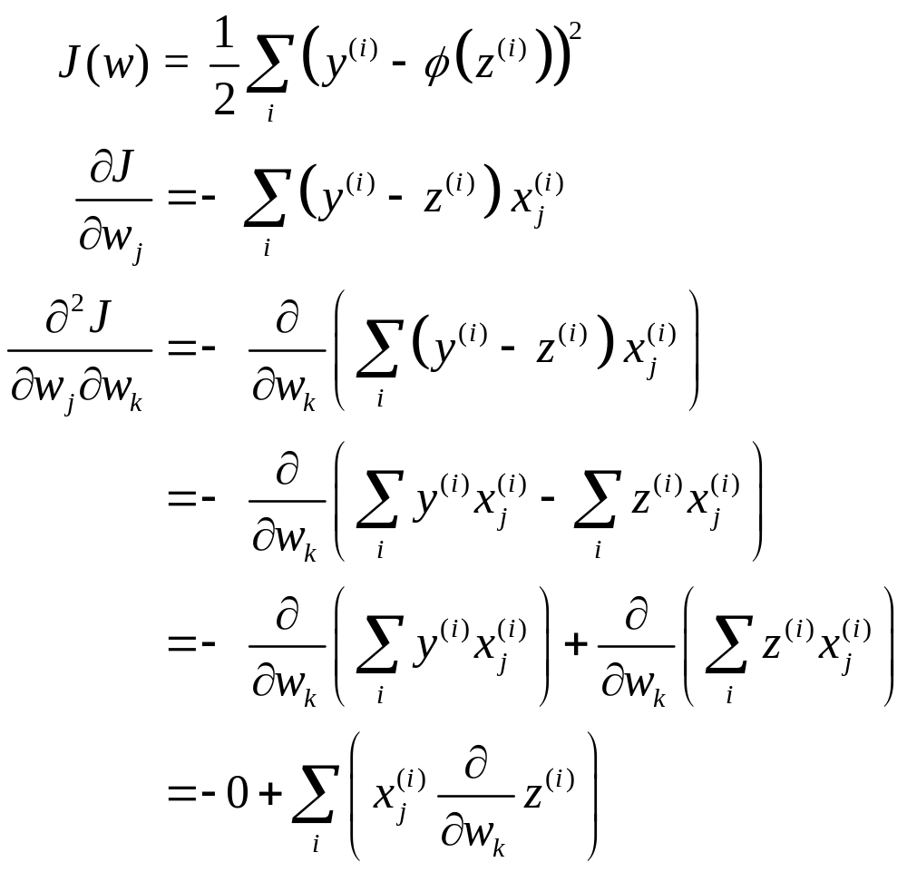
Second derivative of the cost function (1)

Slide 11
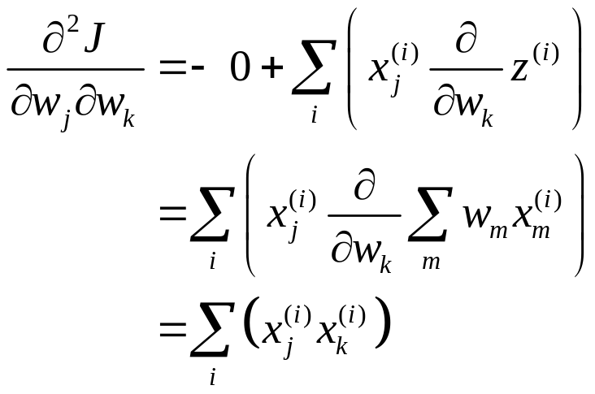
Second derivative of the cost function (2)

Slide 12

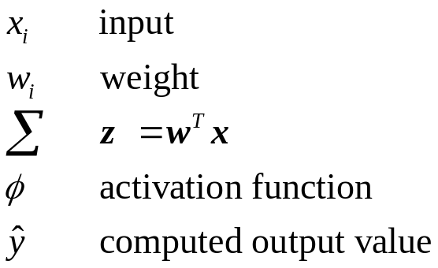
Training a Perceptron
Δw
Inputs
…
Δw
= adjustments to w

Slide 13

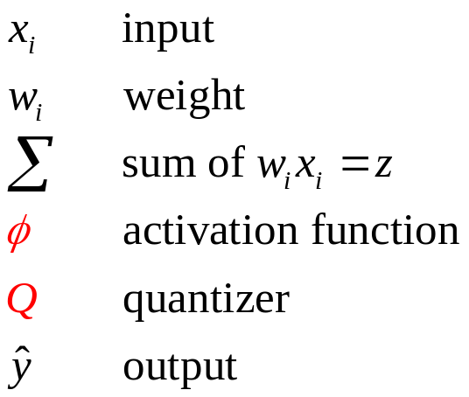
Training an Adaline model (1)
Δw
Inputs
…
Δw
= adjustments to w

Slide 14
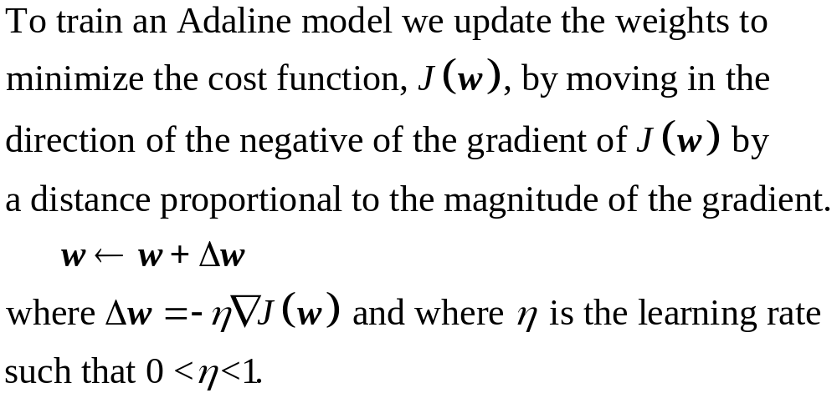
Training an Adaline Model (2)

Slide 15
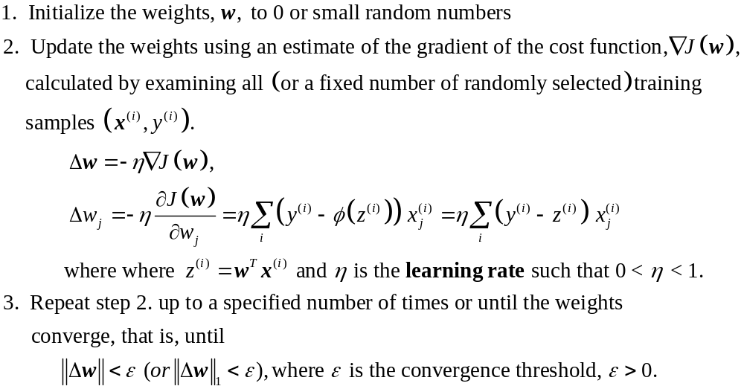
Training an Adaline Model (3)

Slide 16
Variants of the gradient descent technique
  Batch Gradient Descent in which all of the training samples are used for each iteration.
  Stochastic Gradient Descent in which a fixed number of randomly chosen training samples are used for each iteration.

Slide 17
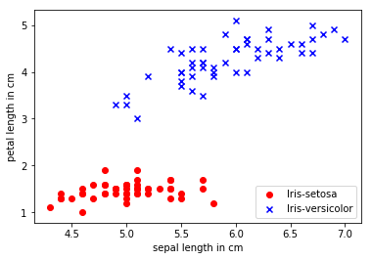
Partial data set setosa and versicolor petal length and sepal length

Slide 18
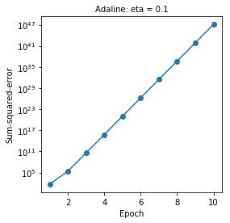
Eta = 0.1

Slide 19
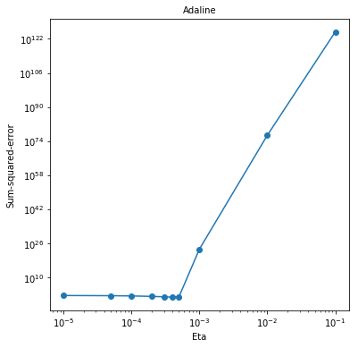
Cost function after 25 epochs (1)

Slide 20
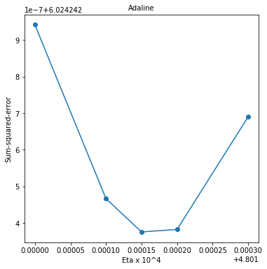
Cost function after 25 epochs (2)

Slide 21
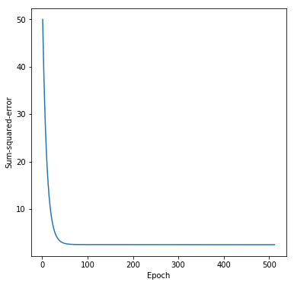
Eta = 0.00048

Slide 22
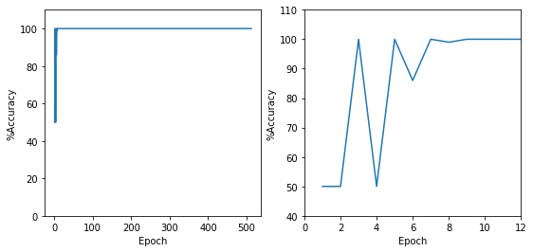
Accuracy by epoch (1)

Slide 23
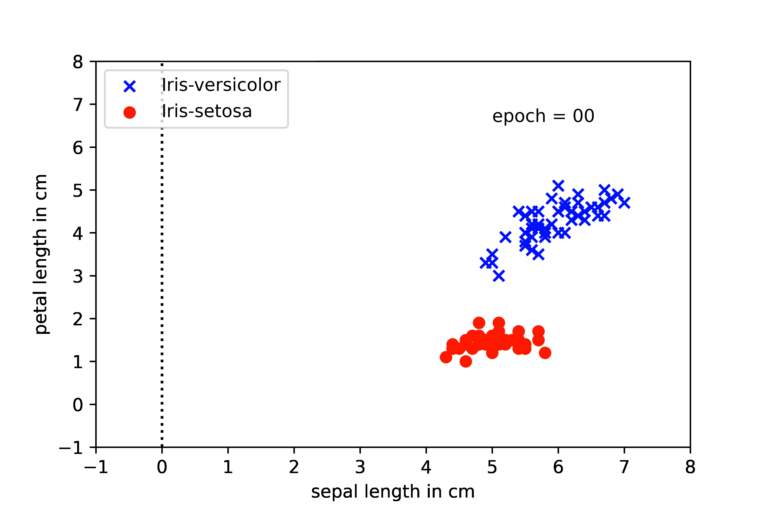
Animation of the decision boundary by epoch (1)

Slide 24
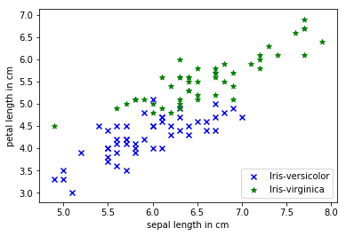
Partial data set -- versicolor and virginica petal length and sepal length

Slide 25
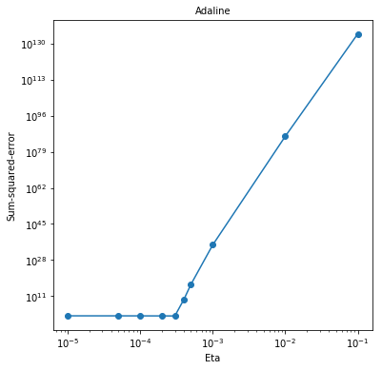
Cost function after 25 epochs (3)

Slide 26
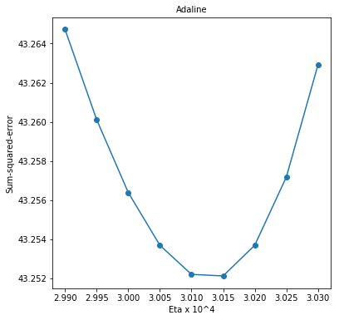
Cost function after 25 epochs (4)

Slide 27
Partial data set versicolor and virginica petal length and sepal length

Slide 28
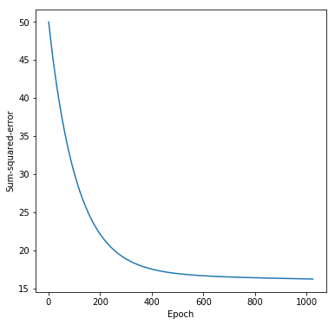
Eta = 0.0003

Slide 29
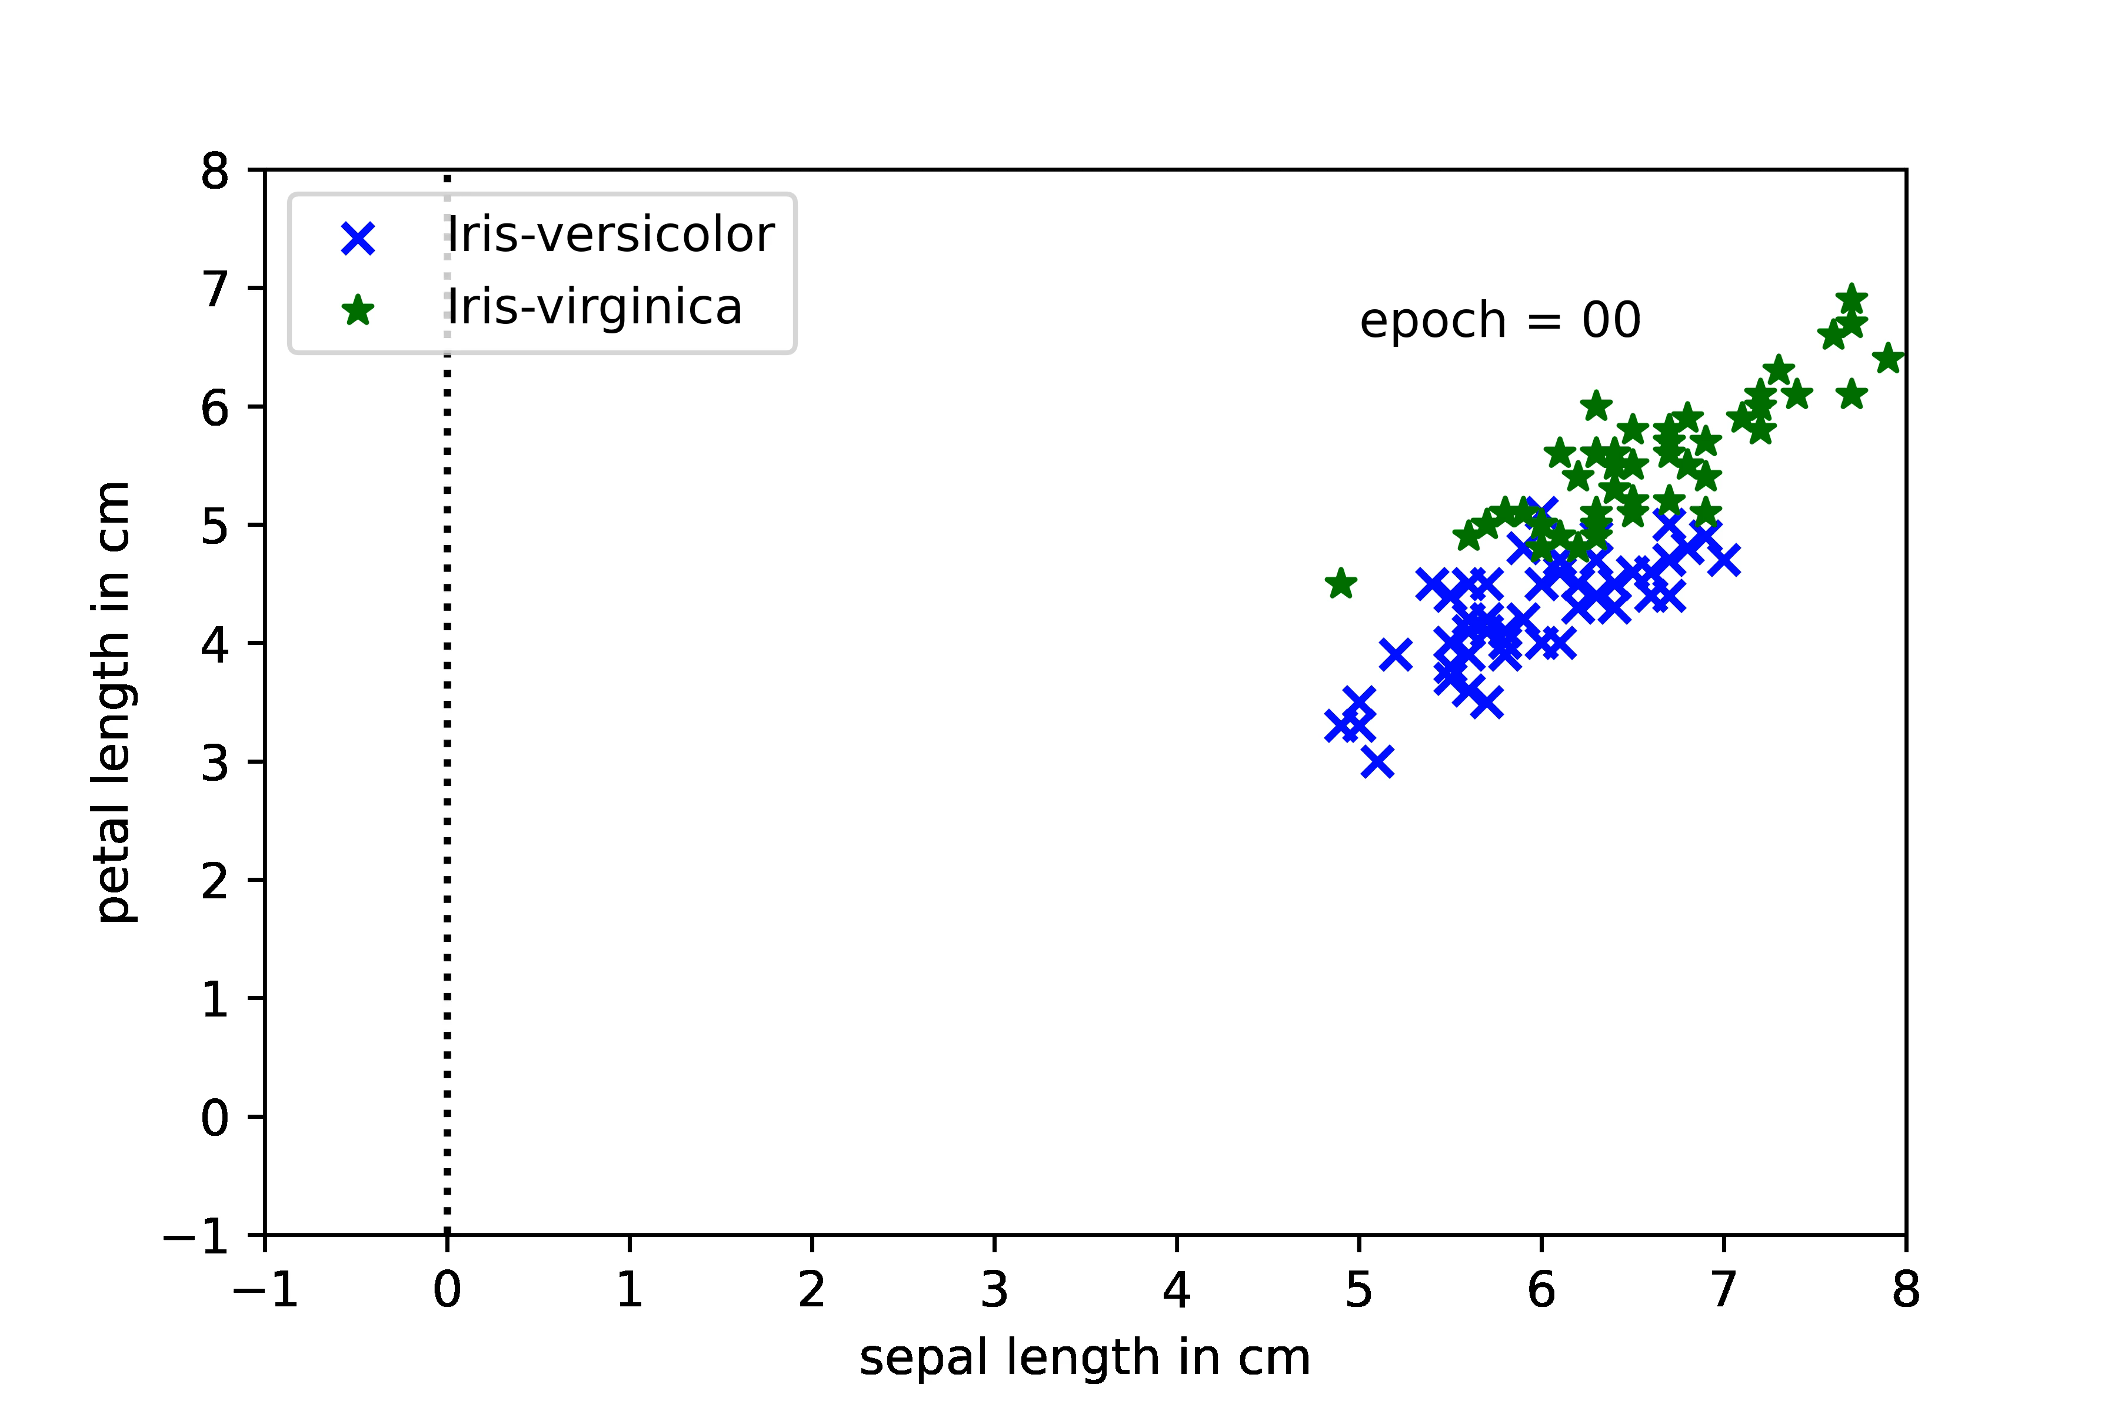
Animation of the decision boundary by epoch (2)

Slide 30
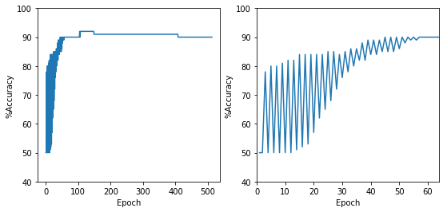
Accuracy by epoch (2)

Slide 31
Scikit-learn Perceptron class
class sklearn.linear_model.Perceptron(…)
Parameter | Default |  | Parameter | Defaults
penalty | None |  | eta0 | 1.0
alpha | 0.0001 |  | n_jobs | 1
fit_intercept | True |  | random_state | 0
max_iter | None |  | class_weight | None
tol | None |  | warm_start | False
shuffle | True |  | n_iter | None
verbose | 0

Slide 32
Scikit-learn Perceptron attributes
Attribute | Description
coef_ | Coefficient of the features in the decision function.
intercept_ | Intercept (a.k.a. bias) added to the decision function
n_iter_ | Actual number of iterations for all classes.

Slide 33
Scikit-learn Perceptron methods
Method | Description
decision_function(X) | Predict confidence scores for samples.
densify() | Convert coefficient matrix to dense array format.
fit(X, y[, coef_int, interscept_int, …]) | Fit linear model with Stochastic Gradient Descent.
get_params([deep]) | Get parameters for this estimator.
partial_fit(X, y[, classes, sample_weight]) | Fit linear model with Stochastic Gradient Descent.
predict(X) | Predict class labels for samples in X.
score(X, y[, sample_weight]) | Returns the mean accuracy on the given test data and labels.
set_params(**params) | Set the parameters of this estimator.
sparsify() | Convert coefficient matrix to sparse format.

Slide 34
Scikit-learn Stochastic Gradient Descent class
class sklearn.linear_model. SGDClassifier(…)
Parameter | Default |  | Parameter | Defaults
loss | hinge |  | n_jobs | None
penalty | l2 |  | random_state | None
alpha | 0.0001 |  | learning_rate | optimal
l1_ratio | 0.15 |  | eta0 | 1.0
fit_intercept | True |  | power_t | 0.5
max_iter | 1000 |  | early_stopping | False
tol | 1e-3 |  | validation_fraction | 0.1
shuffle | True |  | n_iter_no_change | 5
verbose | 0 |  | class_weight | None
epsilon | 0.1 |  | warm_start | False
 |  |  | average | False

Slide 35
Scikit-learn SGD attributes
Attribute | Description
coef_ | Coefficient of the features in the decision function.
intercept_ | Intercept (a.k.a. bias) added to the decision function
n_iter_ | Actual number of iterations for all classes.
loss_function_ | Loss Function
classes_
t_ | Number of weight updates performed.
n_features_in_ | Number of features seen during fit..
feature_nuame_in_ | Names of features seen during fit

Slide 36
Scikit-learn SGD methods
Method | Description
decision_function(X) | Predict confidence scores for samples.
densify() | Convert coefficient matrix to dense array format.
fit(X, y[, coef_int, interscept_int, …]) | Fit linear model with Stochastic Gradient Descent.
get_params([deep]) | Get parameters for this estimator.
partial_fit(X, y[, classes, sample_weight]) | Fit linear model with SGD.
predict(X) | Predict class labels for samples in X.
predict_log_proba(X) | Log of probability estimates
score(X, y[, sample_weight]) | Returns the mean accuracy on the given test data and labels.
set_params(**params) | Set the parameters of this estimator.
sparsify() | Convert coefficient matrix to sparse format.

